Slide 1
MKU
School of Medicine
MBMP 1323 : Cardiovascular Physiology I
Topic: Cardiac Output
By J. Alfred, BSc, MSc, MA, PhD cont.
Email: alfredjuma2015@yahoo.com

Slide 2
While
Cardiac Cycle
The repetitive pumping action that produces pressure changes that circulate blood throughout the body
Cardiac Output
The total amount of blood separately pumped by each ventricle per minute, usually expressed in liters per minute

Slide 3
Cardiac Output
Normal cardiac output = 5 to 6 liters per minute (LPM)
Can increase up to 30 LPM in times of stress or exercise
Determined by multiplying the heart rate by the volume of blood ejected by each ventricle during each beat (stroke volume)
CO = HR x SV
CO is influenced by:
Strength of contraction
Rate of contraction
Amount of venous return available to the ventricle (preload)

Slide 4
Cardiac output vs Venous return
Cardiac output is the quantity of blood pumped into the aorta each minute by the heart.
Venous return is the quantity of blood flowing from the veins into the right atrium each minute.
The venous return and the cardiac output must equal each other except for a few heartbeats at a time when blood is temporarily stored in or removed from the heart and lungs.

Slide 5
Normal Values for CO at Rest & During Activity
Cardiac output varies widely with the level of activity of the body.
Factors which directly affect cardiac output:
(1) Level of body metabolism
(2) Exercise
(3) Age
(4) Size of the body.
For young, healthy men, resting cardiac output averages about 5.6 L/min.
For women, this value is about 4.9 L/min.

Slide 6
Cardiac Index
Experiments have shown that the cardiac output increases approximately in proportion to the surface area of the body.
Cardiac output is frequently stated in terms of the cardiac index, which is the cardiac output per square meter of body surface area.
The normal person weight = 70 Kg
Body surface area = 1.7 sq m
which means that the normal average cardiac index for adults is about 3 L/min/m2 of body surface area.

Slide 7
Effect of Age on Cardiac Output
Cardiac Index Rises rapidly to a level greater than 4 L/min/m2 at age 10 years, the cardiac index declines to about 2.4 L/min/m2 at age 80 years.
The cardiac output is regulated throughout life almost directly in proportion to the overall bodily metabolic activity.
Therefore, the declining cardiac index is indicative of declining activity with age.

Slide 8
Circulatory System
Arteries
Tunica Adventitia
Tunica Media
Tunica Intima
Arteriole
Capillary: 7% of total blood volume
Venule
Vein
Constriction returns 20% (1 liter) of blood to active circulation
}
13% of blood volume
} 64% of blood volume

Slide 9
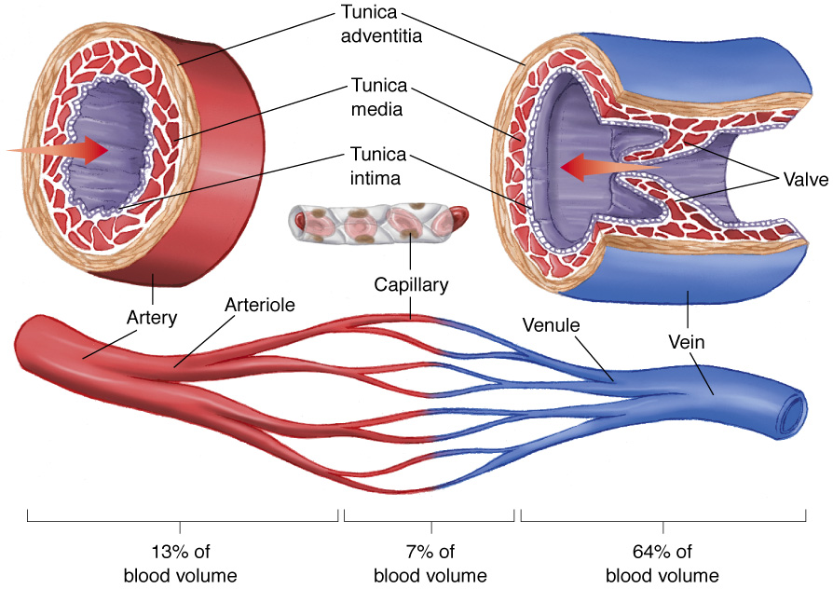
Circulatory System

Slide 10
Circulatory System Key Terms
Stroke Volume
Preload
Ventricular Filling
Starling’s Law of the Heart
Afterload (End Diastolic Pressure or EDP)
Cardiac Output
SV x HR
5 liters/minute
Fick Principle

Slide 11
Fick Principle
A method for measuring cardiac output.
The Fick principle assumes that the quantity of oxygen delivered to an organ is equal to the amount of oxygen consumed by that organ plus the amount of oxygen carried away from that organ.
Used to estimate perfusion either to an organ or to the whole body when oxygen content of both the arterial and venous blood is known and oxygen consumption is assumed to remain fixed.

Slide 12
The Fick Principle
" The total uptake of (or release of) a substance by the peripheral tissues is equal to the product of the blood flow to the peripheral tissues and the arterial-venous concentration difference (gradient) of the substance.“
It is the blood flow we are interested in: this is cardiac output. This method is the purest and most accurate means of estimating the cardiac output.
It is not confused by low output states, valvular regurgitation, shunts or arrhythmias. The major source of error is the act of measuring the amount of exhaled oxygen, and the change in cardiac output over the period of measurement.

Slide 13
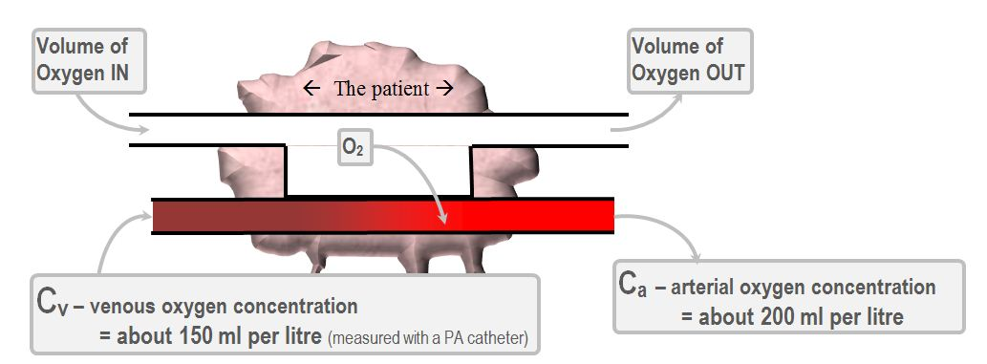
The principle in detail VO2, the oxygen consumption, is simply the difference between the inspired and expired O2. You can measure it with an exhaled gas collection bag. You can also estimate it. Conventionally, resting metabolic consumption of oxygen is 3.5 ml of O2 per kg per minute, or 125ml O2 per square meter of body surface area per minute. Lets say the meaty pinkish lump below is the patient.

Slide 14
We can rearrange that to form an equation which calculates cardiac output on the basis of oxygen extraction:
So, in a normal person, with a body surface area of 2m2 and thus with a VO2 of 250ml per minute,
CO = 250ml / (200ml – 150ml)
= 250 / 50
= 5 L/min
And there you have it. That is the "direct" Ficks method for measuring cardiac output.

Slide 15
Control of Cardiac Output by Venous Return—Role of the Frank-Starling Mechanism of the Heart
When one states that cardiac output is controlled by venous return, this means that it is not the heart itself that is the primary controller of cardiac output.
Instead, it is the various factors of the peripheral circulation that affect flow of blood into the heart from the veins, called venous return, that are the primary controllers.
The main reason peripheral factors are usually more important than the heart itself in controlling cardiac output is that the heart has a built-in mechanism that normally allows it to pump automatically whatever amount of blood that flows into the right atrium from the veins. This mechanism, called the Frank-Starling law of the heart.

Slide 16
Peripheral Vascular Resistance (Afterload)
The total resistance against which blood must be pumped.
It is essentially a measure of friction between the vessel walls and fluid, and between the molecules within the fluid itself (viscosity).
Both oppose flow.
When resistance to flow increases, blood pressure must increase for the flow to remain constant.

Slide 17
Frank-Starling law of the heart,
This law states:
“ When increased quantities of blood flow into the heart, the increased blood stretches the walls of the heart chambers. As a result of the stretch, the cardiac muscle contracts with increased force, and this empties the extra blood that has entered from the systemic circulation”.
Therefore, the blood that flows into the heart is automatically pumped without delay into the aorta and flows again through the circulation.

Slide 18
Starling’s Law of the Heart
When the rate at which blood flows into the heart from the veins (venous return) changes, the heart automatically adjusts its output to match inflow.
The more blood the heart receives the more it pumps…
Increased end diastolic volume increases contractility.
Increases stroke volume.
Increases cardiac output.
Starling curves at any end-diastolic volume.
Increased sympathetic input increases stroke volume.
Decreased sympathetic input decreases stroke volume.

Slide 19
STRETCHING THE HEART CAUSES THE HEART TO PUMP FASTER
Another important factor is that stretching the heart causes the heart to pump faster—at an increased heart rate.
That is, stretch of the sinus node in the wall of the right atrium has a direct effect on the rhythmicity of the node itself to increase heart rate as much as 10 to 15 %
The stretched right atrium initiates a nervous reflex called the BAINBRIDGE REFLEX, passing first to the vasomotor center of the brain and then back to the heart by way of the sympathetic nerves and vagi, also to increase the heart rate.

Slide 20
Cardiac Output Regulation Is the Sum of Blood Flow Regulation in All the Local Tissues of the Body Tissue Metabolism Regulates Most Local Blood Flow
The venous return to the heart is the sum of all the local blood flows through all the individual tissue segments of the peripheral circulation. Blood flow increases in proportion to each tissue’s metabolism.
Local blood flow always increases when tissue oxygen consumption increases
At each increasing level of work output during exercise, the oxygen consumption & the CO increase in parallel to each other.

Slide 21
Effect of Total Peripheral Resistance on the Cardiac Output Level.
The long-term CO level varies reciprocally with changes in total peripheral resistance.
CO= 1/PR
When the total peripheral resistance is exactly normal the cardiac output is also normal.
When the total peripheral resistance increases above normal, the cardiac output falls; conversely, when the total peripheral resistance decreases, the cardiac output increases.

Slide 22
Ohm’s law,
One can easily understand this by reconsidering one of the forms of Ohm’s law
Cardiac Output = Arterial Pressure
Total Peripheral Resistance
The meaning of this formula:
Any time the long-term level of total peripheral resistance changes (but no other functions of the circulation change), the cardiac output changes quantitatively in exactly the opposite direction.

Slide 23
Cardiovascular System Regulation
PNS and SNS always act in balance
Baroreceptors: monitor BP
Chemoreceptors
Hormone regulation
Reabsorption of tissue fluids

Slide 24
Cardiovascular System Regulation
Parasympathetic Nervous System
Decrease
Heart rate
Strength of contractions
Blood pressure
Increase
Digestive system
Kidneys

Slide 25
Cardiovascular System Regulation
Sympathetic Nervous System
Increase
Body activity
Heart rate
Strength of contractions
Vascular constriction
Bowel and digestive viscera
Decreased urine production
Respirations
Bronchodilation
Increases skeletal muscle perfusion

Slide 26
Factors That Can Cause Hyper effective Heart
Only two types of factors usually can make the heart a better pump than normal.
They are
(1) nervous stimulation
(2) hypertrophy of the heart muscle.

Slide 27
A. Effect of Nervous Excitation to Increase Heart Pumping.
Combination of (1) sympathetic stimulation
(2) parasympathetic inhibition
does two things to increase the pumping effectiveness of the heart:
(1) It greatly increases the heart rate— sometimes, in young people, from the normal level of 72 beats/min up to 180 to 200 beats/min—
(2) It increases the strength of heart contraction (which is called increased “contractility”) to twice its normal strength.
Combining these two effects, maximal nervous excitation of the heart can raise the plateau level of the cardiac output curve to almost twice the plateau of the normal curve.

Slide 28
B. Increased Pumping effectiveness Caused by Heart Hypertrophy.
A long-term increased workload, but not so much excess load that it damages the heart, causes the heart muscle to increase in mass and contractile strength in the same way that heavy exercise causes skeletal muscles to hypertrophy.
e.g. it is common for the hearts of marathon runners to be increased in mass by 50 to 75 %. This increases the plateau level of the cardiac output curve, sometimes 60 to 100 %, and therefore allows the heart to pump much greater than usual amounts of cardiac output.
When one combines nervous excitation of the heart and hypertrophy, as occurs in marathon runners, the total effect can allow the heart to pump as much 30 to 40 L/min, about 2 1/2 times normal; this increased level of pumping is one of the most important factors in determining the runner’s running time.

Slide 29
Factors That Cause a Hypo effective Heart
Any factor that decreases the heart’s ability to pump blood causes hypo affectivity.
Some of the factors that can do this are the following:
Coronary artery blockage, causing a “heart attack”
Inhibition of nervous excitation of the heart
Pathological factors that cause abnormal heart rhythm or rate of heartbeat
Valvular heart disease
Increased arterial pressure against which the heart must pump,
such as in hypertension
Congenital heart disease
Myocarditis
Cardiac hypoxia

Slide 30
What Is the Role of the Nervous System in Controlling Cardiac Output?
IMPORTANCE OF THE NERVOUS SYSTEM IN MAINTAINING THE ARTERIAL PRESSURE WHEN THE VENOUS RETURN AND CARDIAC OUTPUT INCREASE
Under normal conditions, the vasoconstrictor area of the vasomotor center transmits signals continuously to the sympathetic vasoconstrictor nerve fibers over the entire body, causing continuous slow firing of these fibers at a rate of about one half to two impulses per second.
This continual firing is called sympathetic vasoconstrictor tone. These impulses normally maintain a partial state of contraction in the blood vessels, called vasomotor tone.

Slide 31
Vasomotion
Regulated primarily by the concentration of oxygen in the tissues.
When oxygen concentration is low, the cells lining and adjacent to the closed capillaries secrete histamine, which is thought to be responsible for arteriolar smooth muscle vasodilation, causing the capillary to open.

Slide 32
Vasomotion
Histamine is quickly destroyed in the blood and does not enter the general circulation.
As cells become re oxygenated they stop the histamine secretion, and the capillary closes.

Slide 33
Vasomotion
A decrease in oxygen concentration leads to a local release of vasodilating substances, which allows blood flow to increase.
This in turn increases the delivery of oxygen and restores aerobic metabolism.

Slide 34
vasomotor center
At the same time that the vasomotor center is controlling the amount of vascular constriction, it also controls heart activity.
The lateral portions of the vasomotor center transmit excitatory impulses through the sympathetic nerve fibers to the heart when there is need to increase heart rate and contractility.
Conversely, when there is need to decrease heart pumping, the medial portion of the vasomotor center sends signals to the adjacent dorsal motor nuclei of the vagus nerves, which then transmit parasympathetic impulses through the vagus nerves to the heart to decrease heart rate and heart contractility.
Therefore, the vasomotor center can either increase or decrease heart activity. Heart rate and strength of heart contraction ordinarily increase when vasoconstriction occurs and ordinarily decrease when vasoconstriction is inhibited.

Slide 35
Effect of the Nervous System to Increase the Arterial Pressure During Exercise
During exercise, intense increase in metabolism in active skeletal muscles acts directly on the muscle arterioles to relax them and to allow adequate oxygen and other nutrients needed to sustain muscle contraction. Obviously, this greatly decreases the total peripheral resistance, which normally would decrease the arterial pressure also.
The nervous system immediately compensates. The same brain activity that sends motor signals to the muscles sends simultaneous signals into the autonomic nervous centers of the brain to excite circulatory activity, causing large vein constriction, increased heart rate, and increased contractility of the heart.
All these changes acting together increase the arterial pressure above normal, which in turn forces still more blood flow through the active muscles.

Slide 36
Pathologically High and Pathologically Low Cardiac Outputs
In healthy human beings, the cardiac outputs are surprisingly constant from one person to another. However, multiple clinical abnormalities can cause either high or low cardiac outputs.
High Cardiac Output Caused by Reduced Total Peripheral Resistance One of the distinguishing features of these conditions is that they all result from chronically reduced total peripheral resistance. None of them result from excessive excitation of the heart itself.

Slide 37
Conditions that can decrease the peripheral resistance & increase the cardiac output to above normal.
1. Beriberi.
This disease is caused by insufficient quantity of the vitamin thiamine (vitamin B1) in the diet. Lack of this vitamin causes diminished ability of the tissues to use some cellular nutrients, and the local tissue blood flow mechanisms in turn cause marked compensatory peripheral vasodilation. Sometimes the total peripheral resistance decreases to as little as one-half normal. Consequently, the long-term levels of venous return and cardiac output also often increase to twice normal.
2. Arteriovenous fistula (shunt).
Whenever a fistula (also called an AV shunt) occurs between a major artery and a major vein, tremendous amounts of blood flow directly from the artery into the vein. This, too, greatly decreases the total peripheral resistance and, likewise, increases the venous return and cardiac output.

Slide 38
3. Hyperthyroidism.
In hyperthyroidism, the metabolism of most tissues of the body becomes greatly increased. Oxygen usage increases, and vasodilator products are released from the tissues. Therefore, the total peripheral resistance decreases markedly because of the local tissue blood flow control reactions throughout the body; consequently, the venous return and cardiac output often increase to 40 to 80 % above normal.
4. Anemia.
In anemia, two peripheral effects greatly decrease the total peripheral resistance.
One of these is reduced viscosity of the blood, resulting from the decreased concentration of red blood cells.
The other is diminished delivery of oxygen to the tissues, which causes local vasodilation.
As a consequence, the cardiac output increases greatly. Any other factor that decreases the total peripheral resistance chronically also increases the cardiac output.

Slide 39
Low Cardiac Output
THESE CONDITIONS FALL INTO TWO CATEGORIES:
(1) Those abnormalities that cause the pumping effectiveness of the heart to fall too low and
(2) Those that cause venous return to fall too low.

Slide 40
Decreased Cardiac Output Caused by Cardiac Factors.
Whenever the heart becomes severely damaged, regardless of the cause, its limited level of pumping may fall below that needed for adequate blood flow to the tissues.
examples
(1) severe coronary blood vessel blockage and consequent myocardial infarction,
(2) severe valvular heart disease,
(3) myocarditis,
(4) cardiac tamponade,
(5) cardiac metabolic derangements.
When the cardiac output falls so low that the tissues throughout the body begin to suffer nutritional deficiency, the condition is called cardiac shock.

Slide 41
Decrease in Cardiac Output Caused by Non-cardiac Peripheral Factors—Decreased Venous Return.
ANYTHING THAT INTERFERES WITH VENOUS RETURN ALSO CAN LEAD TO DECREASED CARDIAC OUTPUT. SOME OF THESE FACTORS ARE THE FOLLOWING:
1. DECREASED BLOOD VOLUME.
By far, the most common non-cardiac peripheral factor that leads to decreased cardiac output is decreased blood volume, resulting most often from hemorrhage. It is clear why this condition decreases the cardiac output: Loss of blood decreases the filling of the vascular system to such a low level that there is not enough blood in the peripheral vessels to create peripheral vascular pressures high enough to push the blood back to the heart.

Slide 42
ACUTE VENOUS DILATION.
On some occasions, the peripheral veins become acutely vasodilated. This results most often when the sympathetic nervous system suddenly becomes inactive. For instance, fainting often results from sudden loss of sympathetic nervous system activity, which causes the peripheral capacitative vessels, especially the veins, to dilate markedly. This decreases the filling pressure of the vascular system because the blood volume can no longer create adequate pressure in the now flaccid peripheral blood vessels. As a result, the blood “pools” in the vessels and does not return to the heart.

Slide 43
3. Obstruction of the large veins.
On rare occasions, the large veins leading into the heart become obstructed, so that the blood in the peripheral vessels cannot flow back into the heart. Consequently, the cardiac output falls markedly.
4. Decreased tissue mass, especially decreased skeletal muscle mass.
With normal aging or with prolonged periods of physical inactivity, there is usually a reduction in the size of the skeletal muscles. This, in turn, decreases the total oxygen consumption and blood flow needs of the muscles, resulting in decreases in skeletal muscle blood flow and cardiac output. Regardless of the cause of low cardiac output, whether it be a peripheral factor or a cardiac factor, if ever the cardiac output falls below that level required for adequate nutrition of the tissues, the person is said to suffer circulatory shock. This condition can be lethal within a few minutes to a few hours.

Slide 44


